Slide 1
CHAPTER TWO
THE PROCESS OF PROJECT QUALITY MANAGEMENT
Notes:
1

Slide 2
Chapter Objectives
After completing this chapter students will be able to understand :
The process of project quality management
Project quality planning tools & techniques
Project quality assurance tools & techniques
Project quality control tools & techniques
Notes:
Quality policy is the overall intention and direction of an organization with regard to quality, as formally expressed by top management.
Project Quality Management is implemented through the policies, procedures, and processes of quality planning, quality assurance, and quality control in the context of continuous process improvement.
Project Quality Management must address the management of the project and the product of the project. Even though PQM applies to all projects, product quality measurements and techniques are specific to the specific type of product being delivered by the project.
Project Management must address the management of the project and the product of the project.

Slide 3
2.1. The Process of Project Quality Management
Quality policy is the overall intention and direction of an organization with regard to quality, as formally expressed by top management.
Project Quality Management is implemented through the policies, procedures, and processes of quality planning, quality assurance, and quality control in the context of continuous process improvement.
Even though PQM applies to all projects, product quality measurements and techniques are specific to the specific type of product being delivered by the project.

Slide 4
Project Management must address the management of the project and the product of the project.
These processes interact with each other and with the processes in the other knowledge areas as well.
Each process may involve effort from one or more individuals or groups of individuals based on the needs of the project.
Each process generally occurs at least once in every project phase.

Slide 5
Therefore, the Project Quality Management Processes addresses:
Quality Planning— identifying which quality standards are relevant to the project and determining how to satisfy them.
Quality Assurance —evaluating overall project performance on a regular basis to provide confidence that the project will satisfy the relevant quality standards.
Quality Control —monitoring specific project results to determine if they comply with relevant quality standards

Slide 6
2.2. Project Quality Plan Tools & Techniques
Knowledge Area | Project Management Process Groups
 | Initiating | Planning | Executing | Monitoring & Controlling | Closing
Project Quality Management | - | Plan Quality | Perform Quality Assurance | Perform Quality Control | -
Notes:
6

Slide 7
2.2.Plan Quality
Definition:
“The process of identifying quality requirements and/or standards for the project and product, and documenting how the project will demonstrate compliance.”
PMBoK® Guide, 4th Edition, p. 192
Quality Management Plans usually include standards, meetings, reports, metrics for quality measurement, what will be measured, and who is accountable for quality.
The only way to know how the project is going and determine when to recommend corrective and preventative actions is to know what is important to measure and what measurement is acceptable.

Slide 8
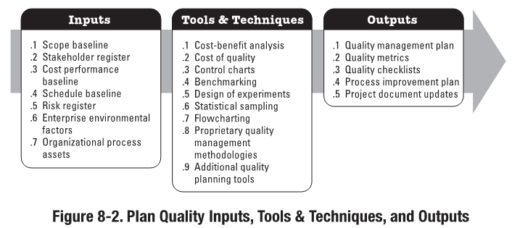

Slide 9
2.2.1. Plan Quality Inputs
1. Scope Baseline | Describes the need, justification, requirements, etc., for the project and is inclusive of the following: Scope Statement: contains the description of services, list of deliverables, acceptance criteria, and important information regarding technical issues that could impact cost estimating. Work Breakdown Structure(WBS): provides the relationship among all the components of the project and deliverables WBS Dictionary: provides detailed statements of work that provide an identification of the deliverables and a description of the work within each WBS component required to produce each deliverable
2. Stakeholder Register | Identifies stakeholders with a particular interest in, or impact on, quality
3.Schedule Baseline | Documents the accepted schedule performance measures, including start and finish dates
Notes:
9

Slide 10
2.2.1.Plan Quality Inputs (cont’d)
4.Cost Performance Baseline | Documents the accepted time phase used to measure cost performance
5.Risk Register | Contains information on threats and opportunities that may impact quality requirements
6.Enterprise Environmental Factors | Factors in the project’s environment that affect the project. Organizational culture, infrastructure, tools, human resources, personnel policies, marketplace conditions, government agency regulations, rules, standards, laws, and guidelines specific to the application area or industry all may have some influence on the project
7.Organizational Process Assets | Organizational quality policies, procedures, guidelines, lessons learned, historical databases, and culture may affect the project
Notes:
10

Slide 11
2.2.2. Plan Quality Tools and Techniques
1.Cost-Benefit Analysis | The primary benefits of meeting quality requirements include: less rework higher productivity lower costs increased stakeholder satisfaction The primary cost is the expense associated with project quality management activities
2. Cost of Quality (COQ) | Includes all costs incurred over the life of the product including preventive and appraising activities, rework, and failure costs Cost of Conformance Prevention Costs Appraisal Costs Cost of Non-conformance Internal Failure Costs External Failure Costs
Notes:
Cost-benefit analysis involves comparing the costs versus the benefits of meeting quality requirements.
11

Slide 12
2.2.2 Plan Quality Tools and Techniques
3.Control Charts | “A graphic display of process data over time and against established control limits, and that has a centerline that assists in detecting a trend of plotted values towards either control limit.”
Upper Specification Limit
Upper Control Limit
3 standard deviations
2 standard deviations
1 standard deviation
Average/Mean
1 standard deviation
2 standard deviations
Lower Control Limit
3 standard deviations
Lower Specification Limit

Slide 13
2.2.2 Plan Quality Tools and Techniques
4. Benchmarking | “Benchmarking involves comparing actual or planned project practices to those of comparable projects to identify best practices, generate ideas for improvement, and provide a basis for measuring performance.”
5. Design of Experiments (DOE) | “A statistical method for identifying which factors may influence specific variables of a product or process under development or in production.” Design of experiments involves the use of experimentation to determine what variables will improve quality.
6.Statistical Sampling | While sampling is not done in planning, you need to consider sample sizes and impact of sampling (e.g.: number of tests, expected scrap, etc.) while developing the plan
7.Flowcharting | “A graphical representation of a process showing the relationship among process steps…..show activities, decision points, and the order of processing….can help the project team anticipate problems that might occur.” Flowcharting – Awareness of potential problems can result in the development of test procedures or approaches for dealing with them.

Slide 14
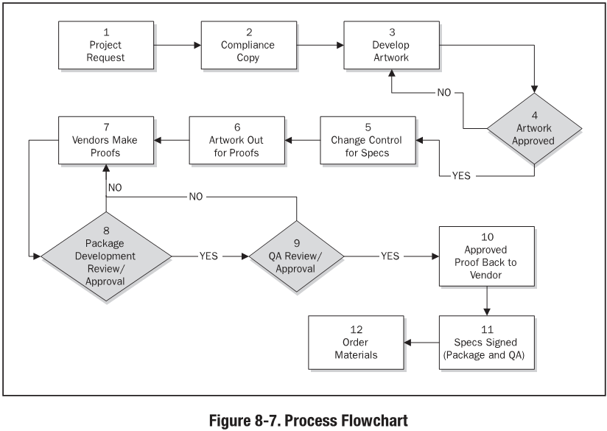
Flowcharting

Slide 15
2.2.2. Plan Quality: Tools and Techniques
8.Proprietary Quality Management Methodologies | Includes: Brainstorming Six Sigma Lean Six Sigma Quality Function Deployment CMMI
9.Additional Quality Planning Tools | Brainstorming Affinity Diagrams Force Field Analysis Nominal Group Techniques Matrix Diagrams Prioritization Matrices

Slide 16
2.2.3 Plan Quality Outputs
1. Quality Management Plan | “The quality management plan describes how the project management team will implement the performing organization’s quality policy.”
2.Quality Metrics | “A quality metric is an operational definition that describes, in very specific terms, a project or product attribute and how the quality control process will measure it.”
3.Quality Checklists | “A checklist is a structured tool, usually component-specific, used to verify that a set of required steps has been performed.”
Notes:
16

Slide 17
2.2.3 Plan Quality Outputs
4.Process Improvement Plan | “The process improvement plan details the steps for analyzing processes to identify activities which enhance their value.”
5.Project Document Updates | Organizational quality policies, procedures, guidelines, lessons learned, historical databases, and culture may affect the project
Notes:
17

Slide 18
2.3 Perform Quality Assurance
Knowledge Area | Project Management Process Groups
 | Initiating | Planning | Executing | Monitoring & Controlling | Closing
Project Quality Management | - | Plan Quality | Perform Quality Assurance | Perform Quality Control | -
Notes:
18

Slide 19
2.3 Perform Quality Assurance
Definition:
“The process of auditing the quality requirements and the results from quality control measurements to ensure appropriate quality standards and operational definitions are used.”
PMBoK® Guide, 4th Edition, p. 201
A Quality Assurance department often oversees quality assurance activities.
QA provides for continuous process improvement.
QA includes determining whether:
Standards are being met
The work is continuously improved
Deficiencies are corrected

Slide 20
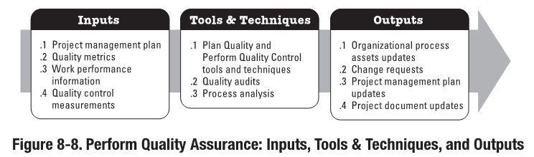

Slide 21
2.3.1. Perform Quality Assurance Inputs
1.Project Management Plan | Described previously and Quality management plan – describes how quality assurance will be performed Process improvement plan – details the steps for analyzing processes to identify activities which enhance their value
2.Quality Metrics | “A quality metric is an operational definition that describes, in very specific terms, a project or product attribute and how the quality control process will measure it.”
3.Work performance information | Technical performance measures Project deliverable status Schedule progress Costs incurred
4.Quality Control Measurements | Quality control measurements are used to analyze and evaluate the quality of the processes and deliverables of the project against the standards of the performing organization or the requirements specified. Quality control measurements can also compare the processes used to create the measurements and validate actual measurements to determine their level of correctness
Notes:
21

Slide 22
2.3.2 Perform Quality Assurance Tools and Techniques
1. Plan Quality and Perform Quality Control Tools and Techniques | The quality management plan is a component of the project management plan that describes how applicable policies, procedures, and guidelines will be implemented to achieve the quality objectives. It describes the activities and resources necessary for the project management team to achieve the quality objectives set for the project.
2.Quality Audits | “A quality audit is a structured, independent review to determine whether project activities comply with organizational and project policies, processes, and procedures”
3.Process Analysis | “Process analysis follows the steps outlined in the process improvement plan to identify needed improvements”
Notes:
22

Slide 23
2.3.3 Perform Quality Assurance Outputs
1.Organizational Process Assets Updates | Including the quality standards
2.Change Requests | Requests to increase effectiveness and/or efficiency of policies, processes, and procedures of the performing organization Used as input into the Perform Integrated Change Control process
3.Project Management Plan Updates | Quality, schedule, and cost management plans, in particular
4.Project Document Updates | Quality audits reports Training plans Process documentation

Slide 24
2.4 Perform Quality Control
Knowledge Area | Project Management Process Groups
 | Initiating | Planning | Executing | Monitoring & Controlling | Closing
Project Quality Management | - | Plan Quality | Perform Quality Assurance | Perform Quality Control | -
Notes:
24

Slide 25
2.4 Perform Quality Control
Definition:
“The process of monitoring and recording results of executing the quality activities to assess performance and recommend necessary changes.”
PMBoK® Guide, 4th Edition, p. 206
QC should be performed throughout the project.
QC can be performed by a dedicated QC department or unit
The project management team should have a working knowledge of statistical quality control, especially sampling and probability, to help in the evaluation of QC outputs.
QC involves monitoring specific project results to determine if they comply with relevant quality standards and identifying ways to eliminate causes of unsatisfactory results.
QC includes product results (deliverables) and project management results (cost and schedule performance).

Slide 26
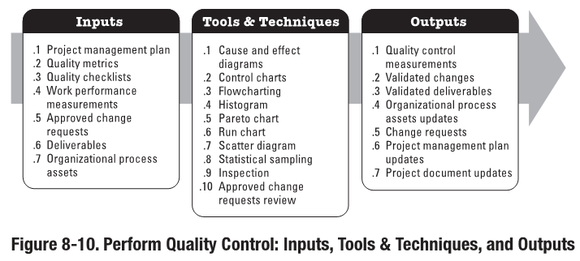

Slide 27
2.4.1 Perform Quality Control Inputs
1. Project Management Plan | The requirements management plan provides the approach for identifying, analyzing, and managing the requirements that the quality management plan and quality metrics will reference.
2.Quality Metrics | A quality metric specifically describes a project or product attribute and how the Control Quality process will verify compliance to it.
3.Quality Checklists | Described previously
4.Work Performance Measurements | Evaluate actual progress as compared to planned progress May include: Planned vs. Actual Scheduled Performance Planned vs. Actual Technical Performance Planned vs. Actual Cost Performance

Slide 28
2.4.1.Perform Quality Control Inputs
5. Approved Change Requests | Part of the Perform Integration Change Control. Change Control status updates indicate approved and unapproved changes. May include: Defect repair Revised work methods and Revised schedule
6. Deliverables | The deliverables are the items whose quality you are checking during Perform Quality Control
7. Organizational Process Assets | May include: Quality Standards and Policies Standard Work Guidelines Issue and Defect reporting procedures and communication policies

Slide 29
2.4.2.Perform Quality Control Tools and Techniques
1. Cause and Effect Diagram | “Cause and effect diagrams, also called Ishikawa diagrams or fishbone diagrams, illustrate how various factors might be linked to potential problems or effects.”Cause and Effect diagrams are a creative way to look at potential causes of a problem or defect.

Slide 30
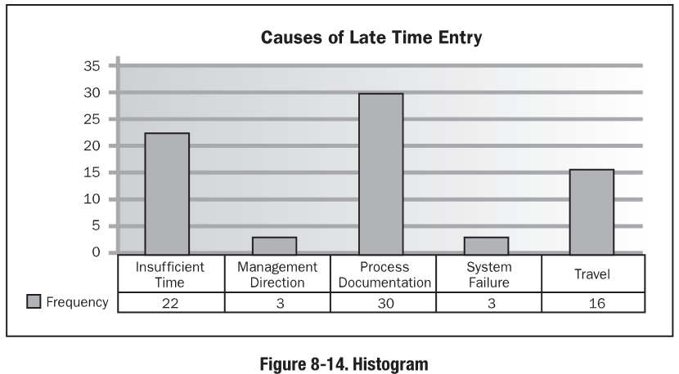
2.4.2.Perform Quality Control Tools and Techniques
1. Control Charts | Described previously
2. Flowcharting | Described in previously
3.Histogram | A vertical bar chart showing a distribution of variables where each column represents an attribute or characteristic of a problem/situation, and the height of the column represents the relative frequency of the characteristic

Slide 31
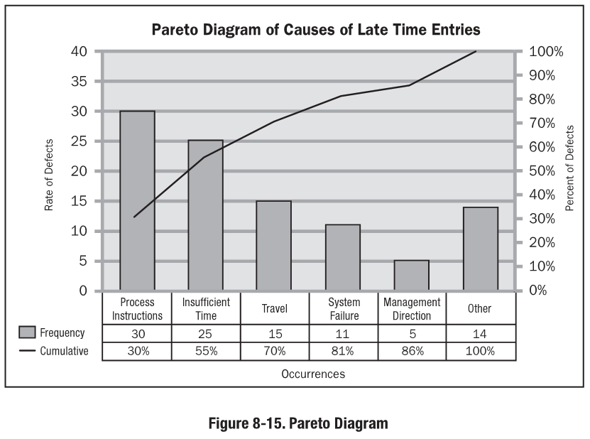
2.4.2.Perform Quality Control Tools and Techniques
4. Pareto Chart | “A histogram, ordered by frequency of occurrence, that shows how many results were generated by each identified cause.”
PMBoK® Guide, 4th Edition, p. 211

Slide 32
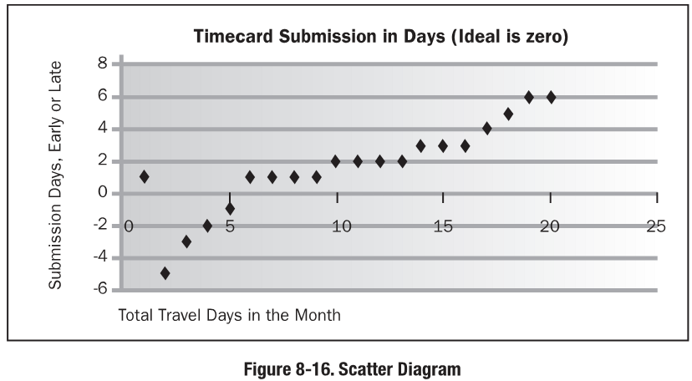
2.4.2.Perform Quality Control Tools and Techniques
5. Run Chart | A Run Chart shows the history and pattern of variation. A run chart is a line graph that shows data points plotted in the order in which they occur. Primarily used in trend analysis which involves mathematical techniques to forecast future outcomes based on historical results. Most often used to analyze: Technical performance Cost and schedule performance
6. Scatter Diagram | “A scatter diagram shows the relationship between two variables. This tool allows the quality team to study and identify the possible relationship between changes observed in two variables.”
PMBoK® Guide, 4th Edition, p. 211

Slide 33
2.4.2.Perform Quality Control Tools and Techniques
8. Statistical Sampling | Described previously
9. Inspection | The examination of a work product or defect repair to determine whether it conforms to documented standards. Also called reviews, peer reviews, audits, or walkthroughs.
10.Approved Change Requests Review | Verify changes were implemented as approved

Slide 34
2.4.3. Perform Quality Control Outputs
1. Quality control measurements | Represent the results of QC activities that are fed back to QA to reevaluate and analyze standards and processes
2. Validated changes | Described previously
3. Validated deliverables | Confirming the correctness of the deliverables. An input to Verify Scope for formalized acceptance.
4.Organizational process assets updates | Completed checklists “Lessons Learned” documentation

Slide 35
2.4.3. Perform Quality Control Outputs
5.Change requests | Issued if the recommended corrective or preventive actions or a defect repair requires a change to the project management plan
6.Project Management Plan updates | In particular: Quality management plan Process improvement plan
7. Project documentation updates | May include Quality Standards documentation

Slide 36
End of the Chapter!!

