Slide 1
Chapter IV
KEY PROJECT SUCCESS FACTORS AND PQM

Slide 2
Learning Objectives
This chapter is intended to give you an understanding about:
Understanding the project success factors
Identifying major project success factors
Understanding how Cost, Time & Quality contributes in Project Success
Know the role of Leadership in a project success

Slide 3


Slide 4
What do we mean by Success?
Success means achieving what is planned.
Success is compromise or agreement from the related group of people on good performance.
Success factors are components that have to be put in place to ensure the completion of the work.

Slide 5
What is Project Success?
For the success of organizations, effective and best management is necessary.
It is also important to examine that to make it sure that right projects are implemented.
Bob Buttrick says that "All those projects which are directed well will be considered as done well". It means that the projects will be successful if they are directed well enough.
Reaching projects' objectives in compliance with constraints of cost, time and performance is insufficient to determine projects' success.

Slide 6
What is Critical Success Factor (CSF)?
Critical Success Factor (CSF) is the term for an element that is necessary for an organization or project to achieve its mission
It is a critical factor or activity required for ensuring the success of business.
The term was initially used in the world of data analysis, and business analysis.
For example, a CSF for a successful project is user involvement.
6

Slide 7
Critical success factors are the limited number of areas in which satisfactory results will ensure competitive performance for the individual, department or organisation.
CSFs include issues vital to an organisation’s or project’s current operating activities and to its future success.
Critical success factors (CSF) define the things that the deliverable requires, and the factors that ultimately define it as successful.
For example, your deliverable could be a house.
Your critical success factors would be construction workers and materials.
Your key success criteria would be the creating a certain number of rooms, doing it within budget, and delivering it on time.
Finally, you could track the progress with schedule-related KPIs.
7

Slide 8
Importance of CSF
Critical success factors are important because they help project managers to:
Facilitate communication between different project stakeholders
Monitor and control scope, changes, and risks
Identify and prioritize goals and tasks
Identify and allocate resources
Remove bottlenecks in knowledge-sharing flows.

Slide 9
What Are Critical and Key Success Factors in Project Management?
According to PRINCE2’s definition, critical success factors (CSFs) are
“elements in a project that are critical to the project achieving its mission or goal.”
“the limited number of areas in which results, if they are satisfactory, will ensure successful competitive performance for the organization”.
‘characteristics, conditions or variables that, when properly sustained, maintained, or managed, can have a significant impact on the success of a firm competing in particular industry’

Slide 10
Early research on project success criteria adopted the so-called Iron Triangle of ‘time, budget and quality’ as the set of principles for evaluating the success of a project.
“Project Success” – it completed on time and budget, with all features and functions as specified(Quality).
Triangle components of time, budget, and quality, include the degree of importance of the products to the base organization, the results as perceived by all stakeholders, the learning experience, motivation for future work, knowledge acquisition, the final report preparation method, and the way of project termination

Slide 11
Major Project Success factors
Here are the most prevalent list of project success factors:
Clearly defined goals -including the general project philosophy or general mission of the project, as well as commitment to those goals on the part of the team members.
Competent project manager. The importance of initial selection of skilled (interpersonally, technically, and administratively) project leader.
Top Management Support. Top or divisional management support for the project that has been conveyed to all concerned parties.

Slide 12
Competent project team members. The importance of selecting and, if necessary, triaging project team members.
Sufficient resource allocation. These are Resources in the form of money, personnel, logistics, etc.
Adequate communication channels. Sufficient information is available on the project objectives, status, changes, organizational coordination, clients’ needs, etc.
7. Control Mechanisms, Including planning, schedules, etc.. Programs are in place to deal with initial plans and schedules.

Slide 13
Feedback capabilities. All parties concerned with the project area able to review project status, make suggestions, and corrections through formal feedback channels or review meetings.
Responsiveness to client. All potential users of the project are consulted with and kept up to date on project status. Further, clients receive assistance after the project has been successfully implemented.
Client consultation. The project team members share solicited input from all potential clients of the project. The project team members understand the needs of those who will use the systems.

Slide 14
Technical tasks. The technology that is being implemented works well. Experts, consultants, or other experienced project managers outside the project team have reviewed and critiqued the basic approach.
Client Acceptance. Potential clients have been contacted about the usefulness of the project. Adequate advanced preparation has been done to best determine how to sell the project to the clients.
Trouble-shooting. Project team members spend a part of each day looking for problems that have surfaced or are about to surface. Project team members are encouraged to take quick action on problems on their own initiative.

Slide 15
In general, project success was recognized that projects could be ‘successful’ in various ways:
In delivery to time.
In delivery to or within budget.
In delivery to specification and an appropriate standard of quality.
In delivery to the funder’s satisfaction.
In delivery to the key stakeholders’ satisfaction.
And, overall.

Slide 16
PROJECT COST MANAGEMENT
Project Cost Management includes the processes involved in planning, estimating, budgeting, financing, funding, managing, and controlling costs so that the project can be completed within the approved budget.
The Project Cost Management processes are:
Plan Cost Management—The process of defining how the project costs will be estimated, budgeted, managed, monitored, and controlled.

Slide 17
Estimate Costs—The process of developing an approximation of the monetary resources needed to complete project work.
Determine Budget—The process of aggregating the estimated costs of individual activities or work packages to establish an authorized cost baseline.
Control Costs—The process of monitoring the status of the project to update the project costs and manage changes to the cost baseline.

Slide 18
MANAGE QUALITY
Manage Quality is the process of translating the quality management plan into executable quality activities that incorporate the organization's quality policies into the project.
The key benefit of this process is that it increases the probability of meeting the quality objectives, as well as identifying ineffective processes and causes of poor quality.
This process is performed throughout the project

Slide 19
PROJECT TIME MANAGEMENT
Project time management specifically refers to developing a schedule that can be met, then controlling work to ensure that this happens.
Because everyone refers to this as scheduling, it should really be called schedule management.
Managers often cite delivering projects on time as one of their biggest challenges.

Slide 20
Determining the time needed to complete the project and scheduling activities to meet that time Critical to the success of the project
Without careful scheduling and planning, a project is at risk of failure
Often regarded as the hardest part of project management
Fifty percent of projects were challenged in the 2019 study, and their average time overrun increased to 82 percent from a low of 63 percent in 2000.
Time/Schedule issues are the main reason for conflicts on projects, especially during the second half of projects.
Time has the least amount of flexibility; it passes no matter what happens on a project.

Slide 21
Importance of Project Schedules
Managers often cite delivering projects on time as one of their biggest challenges.
Fifty percent of IT projects were challenged in the 2003 CHAOS study, and their average time overrun increased to 82 percent from a low of 63 percent in 2000.*
Schedule issues are the main reason for conflicts on projects, especially during the second half of projects.
Time has the least amount of flexibility; it passes no matter what happens on a project.

Slide 22
Project Time Management Processes
Activity definition: Identifying the specific activities that the project team members and stakeholders must perform to produce the project deliverables.
Activity sequencing: Identifying and documenting the relationships between project activities.
Activity resource estimating: Estimating how many resources a project team should use to perform project activities.
Activity duration estimating: Estimating the number of work periods that are needed to complete individual activities.
Schedule development: Analyzing activity sequences, activity resource estimates, and activity duration estimates to create the project schedule.
Schedule control: Controlling and managing changes to the project schedule.

Slide 23
Activity Definition
An activity or task is an element of work normally found on the WBS that has an expected duration, a cost, and resource requirements.
Project schedules grow out of the basic documents that initiate a project.
The project charter includes start and end dates and budget information.
The scope statement and WBS help define what will be done.
Activity definition involves developing a more detailed WBS and supporting explanations to understand all the work to be done, so you can develop realistic cost and duration estimates.

Slide 24
Activity Lists and Attributes
An activity list is a tabulation of activities to be included on a project schedule. The list should include:
The activity name
An activity identifier or number
A brief description of the activity
Activity attributes provide more information about each activity, such as predecessors, successors, logical relationships, leads and lags, resource requirements, constraints, imposed dates, and assumptions related to the activity.

Slide 25
Milestones
A milestone is a significant event that normally has no duration.
It often takes several activities and a lot of work to complete a milestone.
Milestones are useful tools for setting schedule goals and monitoring progress.
Examples include completion and customer sign-off on key documents and completion of specific products.

Slide 26
Activity Sequencing
Involves reviewing activities and determining dependencies.
A dependency or relationship relates to the sequencing of project activities or tasks.
It must determined dependencies in order to use critical path analysis.

Slide 27
Network Diagrams
Network diagrams are the preferred technique for showing activity sequencing.
A network diagram is a schematic display of the logical relationships among, or sequencing of, project activities.
Two main formats are the arrow and precedence diagramming methods.

Slide 28
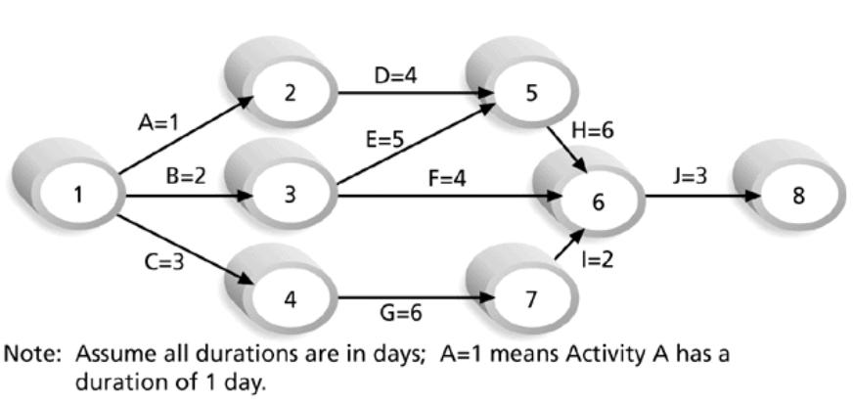
Figure. Sample Activity-on-Arrow (AOA) Network Diagram for Project X

Slide 29
Gantt Charts
Gantt charts provide a standard format for displaying project schedule information by listing project activities and their corresponding start and finish dates in a calendar format.
Symbols include:
Black diamonds: Milestones
Thick black bars: Summary tasks
Lighter horizontal bars: Durations of tasks
Arrows: Dependencies between tasks

Slide 30
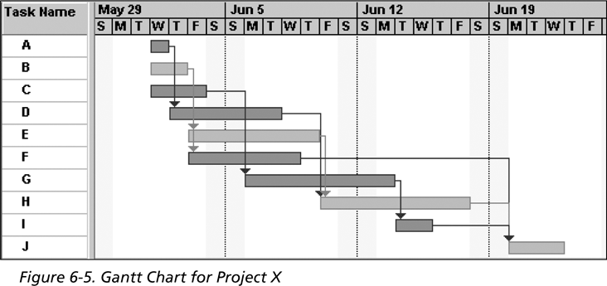
Figure. Gantt Chart for Project X

Slide 31
Time/Schedule Control
Perform reality checks on schedules.
Allow for contingencies.
Don’t plan for everyone to work at 100 percent capacity all the time.
Hold progress meetings with stakeholders and be clear and honest in communicating schedule issues.

Slide 32
Cont’d
Goals are to know the status of the time/schedule, influence factors that cause schedule changes, determine that the schedule has changed, and manage changes when they occur.
Tools and techniques include:
Progress reports.
A time/schedule change control system.
Project management software, including schedule comparison charts, such as the tracking Gantt chart.
Variance analysis, such as analyzing float or slack.
Performance management, such as earned value.

Slide 33
Reality Checks on Scheduling
Review the draft schedule or estimated completion date in the project charter.
Prepare a more detailed schedule with the project team.
Make sure the schedule is realistic and followed.
Alert top management well in advance if there are schedule problems.

Slide 34
Challenges of Project Time/Schedules
Creating realistic schedules and sticking to them is a key challenge of project management.
Crashing and fast tracking often cause more problems, resulting in longer schedules.
Organizational issues often cause schedule problems. See the “What Went Wrong?” example that describes the need to take more time to implement Customer Relationship Management (CRM) software so that users will accept it.

Slide 35
PROJECT LEADERSHIP
Project management refers to project activities of planning and organizing through decision making process which enhance effectiveness and efficiency of project.
Leadership, in contrast, is a process of leading others for achievement of project objectives “motivating and guiding people to realize their potential and achieve tougher and challenging organizational goals”.
The role of a project manager has become so important in today’s organizations and activities of the projects.

Slide 36
Who is Project Manager?
Is an individual with expertise relevant to the project and focal point for the project.
The Project Manager may be engaged at the point of project concept note approval or later – depending on the specific need of the implementing entity.
Leadership style and personal traits have been determined as critical success factor for failure or success of a project, in most of research.
The project leaders motivate and inspire people by satisfying their basic human needs instead of pushing them in right vision.

Slide 37
The specific tasks/assignments may vary, depending on the stage at which the Project Manager gets involved in the project:
Lead the design, planning and implementation of the project, as appropriate;
Lead the Project Team;
Coordinate the preparation of the financing agreement, and arrange the opening of the fund, procurement and recruitment activities;
Coordinate with project specified project stakeholders;
Monitor and report project progress;
Keep the Project Executive informed on project progress.

Slide 38
Role of Leadership in Project Management
Leadership plays a significant role in project management, which:
entails promoting objectives of a project,
Empowering and inspiring project personnel,
Raising moral of the project team,
supporting effective teamwork and
Encouraging positive relationships among others.
It is the responsibility of project manager to influence project team to take necessary actions towards achievement of objectives and goals of a project, which translates, to successful project implementation.

Slide 39
Therefore, effective leadership must take into account three main components of a project, which include time, cost and scope with an intention of meeting them.
Meeting the scope of a project within a given time and at appropriate cost requires effective and proactive leadership.
Thus, leadership is one of the important significant factors in successful project management.
Achieving project objectives require the input of all project personnel.

Slide 40
Thus, leadership plays a role in inspiring the project team to offer quality services with high level of commitment in order to implement a project successfully, that also makes the project leader bear the responsibilities to understand the team abilities and their strength and weaknesses.
Leadership in project management also guide the behaviors by setting vision and direction as well as key processes of projects. Some of the key characteristics of a good project leader include
Being passionate,
Valuing results,
Motivating and inspiring project team,
Being a good listener, good coordinator,
Communicator,
Coach, encourager and dynamic among others.

Slide 41
Success of a project requires commitment of project managers to the project plans.
Project leadership should carefully appoint skilled workforce and be able to adequately define the project.
The leadership should further ensure correct planning of the project activities and adequate flow of information.
It is important that project management accommodate and manage changes as well as support the team’s individual goals. It requires effective leadership to meet the expectations and needs of stakeholders, ensure project success and enhance team development.
Hence, effective project leadership should focus on enhancing organization performance, client satisfaction and successful implementation of projects plans.

Slide 42
Another main requirement of project leadership is managing various kinds of conflict that may arise in the project lifecycle. Sources of conflict from the project management point of view includes:
Unrealistic project schedule- can be source of conflict throughout the project implementations phase. Leadership has a responsibility in planning phase to ensure the schedule is realistic and the match with the team abilities getting the team buy-in the planning phase will give them such feeling of being responsible to project successes and will remove many project schedule conflicts throughout the project executions.

Slide 43
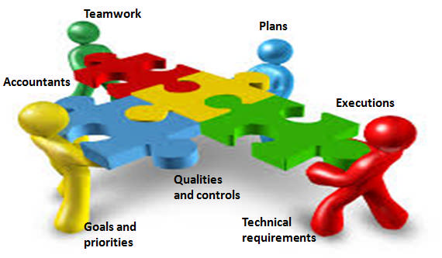
Project constrains and priorities- the project leader will clearly define the constrains and communicate the priorities with the whole team members as well as regularly discuses about it with the teamwork to ensure that all the team are running on the same path
Resourcing issues (Manpower-Materials- Machines)- the leader shall be more integrator than coordinator.
One famous source of conflict is always found in the multinationals organizations, which is the personal conflict- where the leaders shall address the differences and cultural variations among team members.

Slide 44
Leadership styles and project success
Despite the existence of several facets in effective project management, leadership is regarded as the most crucial element.
Leadership plays an important role in ensuring effective project management and enhancing project success by selecting as well as building competent project teams needed to ensure successful implementation of projects.
Leadership plays important roles in project management depending on various leadership styles.

Slide 45
Leadership styles include:
Autocratic leadership
Transactional style
Bureaucratic style
Charismatic
Transformational leadership
Democratic leadership and
Laissez-faire leadership styles among others

Slide 46
Most authors’ recommendation tending more to democratic leadership style, where the managers or leader allows the participation or involvement of project team in decision-making process, discussion and participation in project matters.
Despite the benefits from democratic leadership style, but what if the most of the project team are, a fresh graduated and has a low experience? In this case the bias to the democratic style will not be in a favor of the project, and the importance of autocratic leadership style become much important in such situations.

Slide 47
On the other hand, some authors can argue about the concept of "if the leader makes all the decision alone thereby necessitating resistance from project personnel, which can negatively affect project success”.
That is a justified question, however, there is NO fixed template can be applied for all type of projects or at all situations-Contingency leadership style.
In laissez-faire leadership style, project managers tend to encourage independence among project team with little or no control of the subordinate, however, some authors tend to identify the theory to use in administration more than leadership.

Slide 48
In transactional leadership style project team agree to obey project managers and the leadership tends to reward team members depending on their compliance to regulations and standard, as well as their performance.
Consequently, a transactional leader may punish project team member due to substandard performance.
On the other side, charismatic or transformational leadership is characterized by the ability of leaders to inspire enthusiasm among project team.
Bureaucratic leadership style is where the project managers follow rules strictly and making sure that project personnel follow rules and procedures precisely.
Bureaucratic style is considered appropriate where employees do routine tasks, which involve safety risks or where large amount of money is involved.

Slide 49
Thank you for your attention!
End of Chapter
End of Course

