Slide 1


CHAPTER ONE
BASIC CONCEPTS OF PROJECT QUALITY

Slide 2
  1.1.Quality concepts & Myths
1.1.1. Overview of Quality Concepts
Quality is the totality of features and characteristics of a product or service that bear on its ability to satisfy stated or implied needs.
Some goals of quality programs include:
  Fitness for use. (Is the product or service capable of being used?)
  Fitness for purpose. (Does the product or service meet its intended purpose?)
  Customer satisfaction. (Does the product or service meet the customer's expectations?)
  Conformance to the requirements. (Does the product or service conform to the requirements?)

Slide 3
Quality Management Processes
Quality Planning
Quality Assurance
Quality Control

Slide 4
Quality Planning
The process of identifying which quality standards are relevant to the project and determining how to satisfy them.
  Input includes: Quality policy, scope statement, product description, standards and regulations, and other process Output.
  Methods used: benefit / cost analysis, benchmarking, flowcharting, and design of experiments
  Output includes: Quality Management Plan, operational definitions, checklists, and Input to other processes.

Slide 5
Quality Assurance
The process of evaluating overall project performance on a regular basis to provide confidence that the project will satisfy the relevant quality standards.
  Input includes: Quality Management Plan, results of quality control measurements, and operational definitions.
  Methods used: quality planning tools and techniques and quality audits.
  Output includes: quality improvement.

Slide 6
Quality Control
The process of monitoring specific project results to determine if they comply with relevant quality standards and identifying ways to eliminate causes of unsatisfactory performance.
  Input includes: work results, Quality Management Plan, operational definitions, and checklists.
  Methods used include: inspection, control charts, pareto diagrams, statistical sampling, flowcharting, and trend analysis.
  Output includes: quality improvements, acceptance decisions, rework, completed checklists, and process adjustments

Slide 7
1.1.2.Major Approaches & Contributors to Quality and Quality Management
Deming
Juran
Crosby
TQM
Six Sigma
ISO 9000

Slide 8
Edwards Demming on Quality
Quality is an attribute of a product or service that can only be defined by the customer.
Because of this its meaning is relative
Quality or lack of it is one of the outcomes of the specific business process that produces a product or service
Quality is produced by proper execution of such a process
The job of quality management is to provide the system and the leadership to facilitate such proper execution

Slide 9
Joseph M. Juran: Quality
Quality is “fitness for use”
Balance between product features and products free from deficiencies
Features must meet customer expectations
Absence of deficiency is as essential as desired features in producing customer satisfaction
So the ultimate test of quality is fitness for use by customers as reflected by customer satisfaction

Slide 10
Juran: The Trilogy of Quality Management
Quality Planning
  developing a process to achieve goals involving customer satisfaction
Quality Control
  holding onto gains, controlling variation, preventing waste
Quality Improvement
  lowering cost of poor quality achieving innovation in performance

Slide 11
Philip B. Crosby: on Quality
Conformance to requirements
Must be defined in measurable terms and expressed as a clear target
Either present or not present
The Cost of Quality (COQ) = Price of Conformance (POC) + Price of Non-Conformance (NPOC)
POC is cost of getting things done right the first time
NPOC is the cost of waste

Slide 12
Crosby: Four Absolutes of Quality
Conformance to the requirements: This idea of quality must be integrated into the enterprise
The system of quality is prevention (eliminating errors before they occur)
The performance standard is zero defects
The measure of quality is the PONC: the lower the PONC the more widespread the quality
These four absolutes must be attained through strong discipline, complete leadership commitment, substantial resource allocation for training, tools, and appropriate personnel, and Crosby’s 14-step approach to achieving conformance.

Slide 13
Total Quality Management: Quality
“We define quality as consistently producing what the customer wants while reducing errors before and after delivery to the customer. More importantly, however, quality is not so much an outcome as a never ending process of continually improving the quality of what your company produces.”
Close derivative of Deming’s approach to Quality

Slide 14
Total Quality Management
“A structured system for satisfying employees, customers, and suppliers by integrating the business environment, continuous improvement, and breakthroughs with development, improvement, and maintenance cycles while changing organizational culture” .
  Great emphasis on needs and requirements analysis
  Uses a systems approach with strong emphasis on both cultural and technological elements
  Strong emphasis on prevention and role of
  leadership
  Closely related to Deming’s approach to QM

Slide 15
Six Sigma: Quality
The value added by a productive endeavour
Potential quality is the maximum possible value added per unit of input.
Actual quality is the current value added per unit of input
The difference between the two is waste Six Sigma is focused on reducing waste, cycle time, defects, and those costs that do not add value
Goal is virtually error-free performance

Slide 16
Six Sigma: Key Elements
Implements “proven” quality principles and and a select few of the myriad QM techniques
Performance is measured by the sigma level measure of variability in the company’s business processes
Uses a Define-Measure-Analyze-Improve-Control (DMAIC) model
Define goals
Measure existing system and processes
Analyze (including stat analysis) & develop plan closing gap
Improve system (Use stat methods to validate)
Control the new system by institutionalizing it through new policies and rules

Slide 17
Six Sigma: Implementation approach
Senior leadership training in principles & tools for organization success, followed by SLs directing development of management infrastructure & innovation-friendly culture supporting Six Sigma.
Develop systems establishing close communication with customers, employees, & suppliers. Includes rigorous methods and ways of overcoming cultural, policy, and procedural barriers
Rigorously assess training needs, provide remedial basic skills education, and comprehensive training in systems improvement tools, techniques, and philosophies
Develop framework for continuous process improvement along with system of indicators for monitoring progress and success.
Projects for improving business performance linked to measurable financial results.

Slide 18
ISO 8402 and 9000: Quality and QM
“The totality of characteristics of an entity that bear on its ability to satisfy stated and implied needs” ISO 8402
Quality management: activities performed to formulate and implement policies and programs intended to achieve quality.
Examples:
  quality planning,
  quality control,
  quality assurance, and
  quality improvement

Slide 19
ISO 9000: Eight Principles
Customer Focus (on needs and requirements)
Leadership (establish unity of purpose, direction, environment for participation)
Involvement of people (full)
Process Approach (managing activities & resources)
Systems Approach to Management (of inter-related processes)
Continual Improvement (of processes and performance)
Factual Approach to Decision Making (analysis of data/info)
Mutually Beneficial supplier relationships

Slide 20
1.1.3.Quality Concepts
Do the Right Thing Right the First Time (DTRTRTFT)
  Implies that it is easier and less costly to do the work right the first time than it is to do it the second time.
  Entails the training of personnel to ensure sufficient skills and tools to correctly complete the work.
Continuous Improvement Process (CIP) (From Japanese word, Kaizen)
  A sustained, gradual change to improve the situation.
  Differs from innovation -- does not make a sudden jump to a plateau where it matures over time.

Slide 21
Quality Concepts
Zero Defects
  Implies that there is no tolerance for errors within the system.
  The goal of all processes is to avoid defects in the product or service.
  Similar to six sigma: almost zero defects
The Customer is the Next Person in the Process
  The internal organization has a system that ensures the product or service is transferred to the next person in the process in a complete and correct manner.
  The product or service being built is transferred to another internal party only after it meets all the specifications and all actions at the current work station.
  Avoids incorrectly assembled components and poor workmanship.

Slide 22
Cont’d
Quality does not necessarily imply:
  Most expensive
  Most sophisticated, most features
  Most reliable
Good quality implies cost-effectiveness and fitness for a specific intended purpose
Quality is not the same as Grade
  Grade is a rank or category of type of item e.g. grades of steel include categories such as stainless steels, tool steels, steels for pressure vessels, etc.

Slide 23
1.1.4. Myths on Quality Management
Myth is “an unproved or false collective belief that is used to justify a social institution”.
Why Talk about these?
  Pride in Profession
  Bring Clarity
  Establish realistic goals/objectives
  Don't waste your career

Slide 24
1. Quality management systems require excessive documentation and paperwork
Is This True?
Many QMS failures come from organizations creating documents that do not add value. This is often because the organization incorrectly believes that the management system is all about documents and procedures.
QMS ISO 9001:2008, requires only six documented procedures, enough to provide transparency, structure, and confidence to the organization, its customers, and its employees. Beyond this, the number of documented procedures depends upon the organization’s size, types of activities, and operational needs.

Slide 25
Excessive documentation will, in fact, reduce the management system’s value to the organization and its customers and should be considered counterproductive.
An organization that adopts a QMS standard should proceed with a focus on results and practicality, not documents. The intent should be to add bottom- line value to the organization and its customers. The implemented management system should become part of the day-to-day operation of the organization.

Slide 26
2. QMS don’t add value but it is only for customers want to have one
Is This True?
Organizations that are not achieving value from their management systems may not be clear on their true purpose and may be just going through the motions.
Management systems provide bottom-line cost savings and improved profitability and performance through embedded preventive practices.
Organizations of any size performing activities of any kind that are considering adopting a management system standard can expect to see increased value to customers and greater return on investment through appropriate discipline and communication.

Slide 27
3. Management systems are a net cost to my organization
Is This True?
Excessive costs associated with management systems often come from an organization’s failure to take ownership of the completed management system. This is particularly true if there is a lack of ownership on the part of top management.
If you create a system that you are unwilling to work with on a daily basis, it will provide little or no value, and, in fact, may be a net cost to the organization.
Preventing a problem is less expensive—and in many cases much less expensive—than dealing with the consequences after a problem occurs.
If an organization implements a management system standard and its net cost increases, the organization needs to examine and reconsider its approach to implementing the management system.

Slide 28
4. Management system standards do not allow my organization to be flexible and innovative
Is This True?
Management systems are written in a way that serves any organization. If an organization has an inflexible management system that ties the organizations hands, it is because the management system was created that way.
Careful decisions are required to balance the need for discipline and structure on one hand and the need for flexibility on the other.
During management system implementation, the organization will need to make decisions that allow it to remain flexible where flexibility is important, while at the same time providing enough structure to ensure good discipline where discipline is needed.

Slide 29
5. Management systems don’t help my business; in fact, they distract my organization from its core activities
Is This True?
This myth will almost certainly come true for organizations that use a plug-and-play approach to implementing a management system, instead of making sure documents and practices fit their businesses.
Organizations can avoid this problem by adopting management system standards and implementing them in a manner that fulfills its needs and the needs of its customers and stakeholders.
Organizations that recognize this and live by their management systems on a daily basis will achieve benefits that greatly exceed any cost or effort.

Slide 30
6. Management system standards do not guarantee product quality
Is This True?
Nothing can absolutely guarantee product quality. However, management systems can go a long way toward preventing problems from occurring in the first place, thus providing dramatic improvements in results while reducing costs.
While management systems do not assure absolute results, the preventive steps embedded in management systems will dramatically increase the likelihood of consistent product and overall business success.

Slide 31
1.2. What is Project Quality Management?
Quality management, from the point of view of project, will have another dimension of the definition that comes from various stakeholders and sources.

Slide 32
1.2.1. Identifying quality standards
Identifying quality standards is a key component of quality definition that will help identify the key characteristics that will govern project activities and ensure the beneficiaries and donor will accept the project outcomes.
Quality management implies the ability to anticipate situations and prepare actions that will help bring the desired outcomes.
The goal is the prevention of defects through the creation of actions that will ensure that the project team understands what is defined as quality.

Slide 33
1.2.2. Sources of Quality Definition in Projects
1. Donors
  One source for definition of quality comes from the donor;
  The project must establish conversations with the donor to be familiar with and come to a common understanding of what the donor defines as quality.
  The donor may have certain standards of what is expected from the project, and how the project delivers the expected benefits to the beneficiaries.
  This is in line with the project’s ultimate objective that the project outcomes have the ability to satisfy the stated or implied needs.

Slide 34
2. Beneficiary
  Another source for quality definition comes from the beneficiaries;
  The project team must be able to understand how the beneficiaries define quality from their perspective, a perspective that is more focused on fitness for use, the project outcomes must be relevant to the current needs of the beneficiaries and must result in improvements to their lives.
  The project team can create, as part of the baseline data collection, questions that seek to understand how the beneficiaries define the project will meet their needs, and a question that also helps define what project success looks like from the perspective of a beneficiary.

Slide 35
3. The Organization
  The development organization may have its own quality standards that can reflect technical and managerial nature of the project.
  The organization may require from the project timely and accurate delivery of project information needed for decision making, or compliance to international or locally recognized quality standards that define specific technical areas of the project, this is quite often in health, water and nutrition projects.

Slide 36
4.International standard(Sphere Standard)
  A worldwide recognized standard for project is the Sphere Standard (www.sphereproject.org), used for emergency projects whose aim is to improve the quality of assistance provided to people affected by disasters.
  This guideline defines the minimum standards for water, sanitation, health, shelter, food security, nutrition, shelter and settlement.

Slide 37
1.2.3. Definition of Quality in projects
The project manager and the team must identify what quality standards will be used in the project, it will look at what the donor, beneficiaries, the organization and other key stakeholders to come up with a good definition of quality.
In some instances the organization or the area of specialization of the project (health, water or education) may have some standard definitions of quality that can be used by the project.
Quality has been defined as "the totality of characteristics of an entity that bear on its ability to satisfy stated or implied needs.”The stated and implied quality needs are the inputs used in defining project requirements from the donor and the beneficiaries.

Slide 38
Project Quality definition
A subset of project management that includes the processes and activities of the performing organization that determine quality policies, objectives, and responsibilities so that the project will satisfy the needs for which it was undertaken.

Slide 39
It is also defined as the “Conformance to requirements or fitness for use”; which means that the product or services must meet the intended objectives of the project and have a value to the donor and beneficiaries and that the beneficiaries can use the material or service as it was originally intended.
The central focus of quality management is meeting or exceeding stakeholder’s expectations and conforming to the project design and specifications.

Slide 40
The ultimate judge for quality is the beneficiary, and represents how close the project outputs and deliverables come to meeting the beneficiaries’ requirements and expectations.
How a beneficiary defines quality may be completely subjective, but there are many ways to make quality objective; by defining the individual characteristics and determine one or more metrics that can be collected to mirror the characteristic. For instance, one of the features of a quality product may be that it has a minimum amount of errors. This characteristic can be measured by counting errors and defects after the product is used.
Therefore:
  Quality management is not an event - it is a process, a consistently high quality product or service cannot be produced by a defective process.
  Quality management is a repetitive cycle of measuring quality, updating processes, measuring, updating processes until the desired quality is achieved.

Slide 41
1.3. Project Characteristics/Attributes that bear on quality
1.3.1. Manufacturing attributes of Quality
1. Producibility (technology required)
Ability of a product or service to be produced within the existing technology, human resources, skills, knowledge, and materials at a cost compatible with market expectations.
Producibility is one of the most critical aspects of developing any new product.
2. Usability (effort expended to use)
The ability of a product to perform its intended function for the specified user under the prescribed conditions.
Usability is determined by examining performance, function and condition of a product.

Slide 42
Cont’d
3.Reliability (MTBF)
The degree to which a unit of equipment performs its intended function under specified conditions for a specified period of time.
Computed by 2 methods of Mean-Time-Between-Failure (MTBF):
  Predicted MTBF: Based on a mathematical computation of a component failure using a tree diagram to determine sequential failure aspects of the component rated periods. Least desirable method because it cannot account for environmental variations that can degrade components to lower rates.
  Actual MTBF: Use of field collected data to compute the failures under realistic operating conditions to find the average time between failure. The actual reliability will seldom be the same as the predicted reliability

Slide 43
Cont’d
4. Maintainability (Mean-Time-To-Repair: MTTR)
The ability of a unit to be restored within a specified time to its performance capability under the environmental operating conditions within a specified, average period of time.
Availability (Probability of performance)
The probability of a product being capable of performing a required function under the specified conditions when called upon.
The key parts of availability are reliability and maintainability.
5.Operability (Expected conditional use)
The ability of a product to be operated by human resources for specified periods of time under given conditions without significant degradation of the output.

Slide 44
Cont’d
6. Flexibility (Expected variable use)
  The ability of a product to be used for different purposes at different capacities and under different conditions.
7. Social Acceptability (Environment and safety)
  The degree of compatibility between the characteristics of a product or service and the prevailing values and expectations of the relevant society
  The degree to which a public accepts a product for use.
8. Affordability (Return for quality required)
  The ability to develop, acquire, operate, maintain, and dispose of a product over its life.

Slide 45
1.3.2. Service Attributes of Quality
Reliability
  It is the ability of the service or product to perform as intended under normal conditions without unacceptable failures.
  Material used for blood testing should be able to provide the information in a consistent and dependable manner that will help identify critical diseases.
  The trust of the beneficiaries depend on the quality of the tests

Slide 46
Cont’d
2. Relevance
  it’s the characteristic of how a product or service meets the actual needs of the beneficiaries, it should be pertinent, applicable, and appropriate to its intended use or application
3.Timeliness
  how the service is delivered in time to solve the problems when its needed and not after, this is a crucial characteristic for health and emergency relief work

Slide 47
4.Suitability
  the fitness of its use, it appropriateness and correctness, the agriculture equipment must be designed to operate on the soil conditions the beneficiaries will use it on.
5.Completeness
  the quality that the service is complete and includes all the entire scope of services. Training sessions should be complete and include all the material needed to build a desired skill or knowledge
6. Consistency
  services are delivered in the same way for every beneficiary. Clinical tests need to be done using the same procedure for every patient.

Slide 48
1.4.Quality and People in Project Management
Management defines type and amount of work
Management is 85% responsible for quality
The employee can only assume responsibility for meeting the requirements of completing the work when the employee:
  Knows what's expected to meet the specifications
  Knows how to perform the functions to meet the specifications
  Has adequate tools to perform the function
  Is able to measure the performance during the process
  Is able to adjust the process to match the desired outcome

Slide 49
Cont’d
Project quality team consists of:
  Senior Management
  Project Manager
  Project Staff
  Customer/Client
  Vendors, suppliers, and contractors
  Regulatory Agencies

Slide 50
1.5. Project Management Maturity Model
In organizations where we have done assessments, we have seen that the evolution of project management typically lags behind development of other capabilities within a company.
It isn’t until the need for project management becomes critical that organizations pay attention to improving the project management skills within their organization. organization.
This lack of foresight frequently creates an environment where the project management systems and infrastructure are not in place to support the needs of the practicing project management community.

Slide 51
There are a great number of interrelated challenges to deal with in improving an organization’s infrastructure:
  Project managers aren’t getting the information they need to manage effectively;
  Management is not getting accurate forecasts of completion data;
  There is inconsistent understanding of expectations, etc.

Slide 52
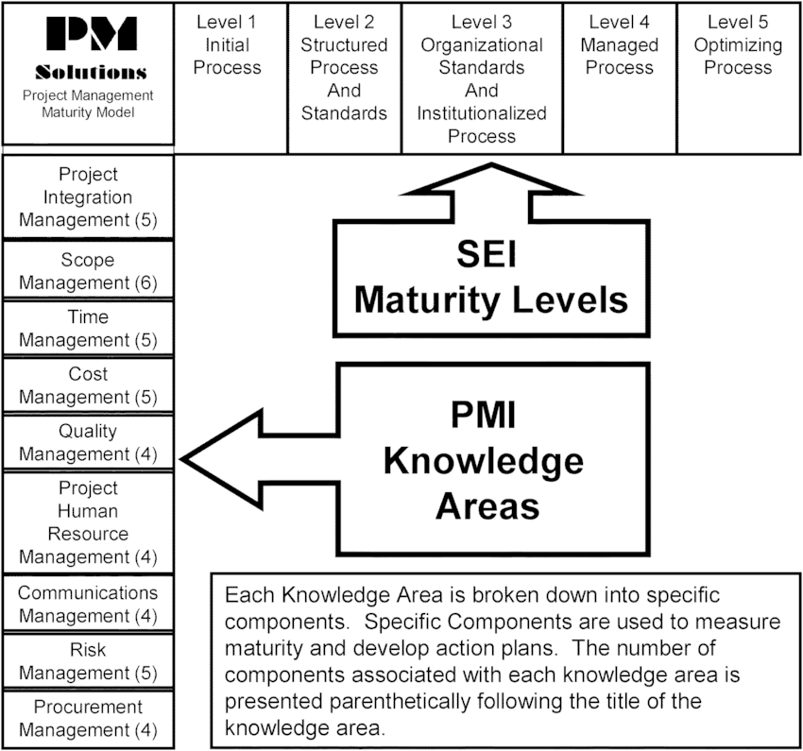

Slide 53
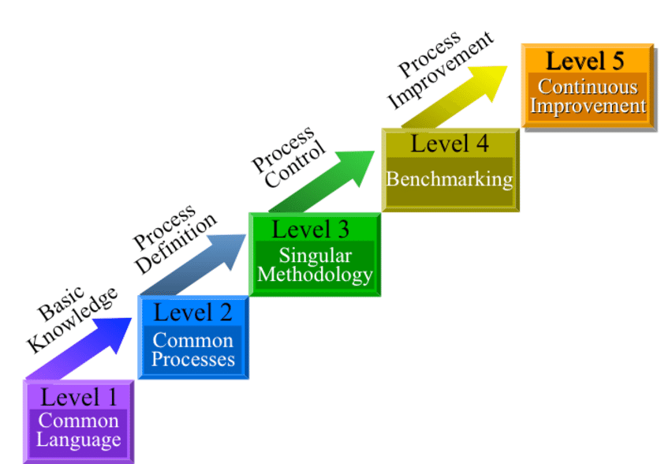

Slide 54
Meaning of Project Maturity Level
It is alignment of an organization’s projects to
    its strategic goals 3-domain structure: projects, programs, portfolio;
    3-phase implementation: knowledge, assessment, improvement and;
    five-step iterative cycle; level1upto level 5
    It emphasizes assessment and continuous improvement, and; the adoption and enhancement of best practices
  The degree to which organizations practice this kind of practice is referred to as project maturity.
  Maturity is reflected by the combinations of best practices achieved within the Project, Program and portfolio domain.

Slide 55
Level 1: Initial Process
Although there is a recognition that there are project management processes, there are no established practices or standards, and individual project managers are not held to specific accountability by any process standards.
Documentation is loose and ad hoc.
Management understands the definition of a project, that there are accepted processes, and is aware of the need for project management.
Metrics are informally collected on an ad hoc basis.

Slide 56
Level 2: Structured Process and Standards
Many project management processes exist in the organization, but they are not considered an organizational standard.
Documentation exists on these basic processes.
Management supports the implementation of project management, but there is neither consistent understanding, involvement, nor organizational mandate to comply for all projects.

Slide 57
Functional management is involved in the project management of larger, more visible projects, and these are typically executed in a systematic fashion.
There are basic metrics to track project cost, schedule, and technical performance, although data may be collected/correlated manually.
Information available for managing the project is often a mix between summary-level data and detail-level data

Slide 58
Level 3: Organizational Standards and
Institutionalized Process
All project management processes are in place and established as organizational standards and these processes involve the clients as active and integral members of the project team.
Nearly all projects use these processes with minimal exception management has institutionalized the processes and standards with formal documentation existing on all processes and standards.
Management is regularly involved in input and approval of key decisions and documents and in key project issues.
The project management processes are typically automated.
Each project is evaluated and managed in light of other projects.

Slide 59
Level 4: Managed Process
Projects are managed with consideration as to how the project performed in the past and what is expected for the future.
Management uses efficiency and effectiveness metrics to make decision regarding the project and understands the impacts on other projects.
All projects, changes, and issues are evaluated based upon metrics from cost estimates, baseline estimates, and earned value calculations.
Project information is integrated with other corporate systems to optimize business decisions.

Slide 60
Cont’d
Processes and standards are documented and in place to support the practice of using such metrics to make project decisions.
Management clearly understands its role in the project management process and executes it well, managing at the right level, and clearly differentiating management styles and project management requirements for different sizes/complexities of projects.
Project management processes, standards, and supporting systems are integrated with other corporate processes and systems.

Slide 61
Level 5: Optimizing Process
Processes are in place and actively used to improve project management activities.
Lessons learned are regularly examined and used to improve project management processes, standards, and documentation.
Management and the organization are focused not only on effectively managing projects but also on continuous improvement.
The metrics collected during project execution are used not only to understand the performance of a project but also for making organizational management decisions for the future.

Slide 62
Many organizations will achieve significant benefit by reaching the repeatable process level area.
In effect, a good model for the measurement of project management maturity creates a strategic plan for moving project management forward in an organization.

Slide 63
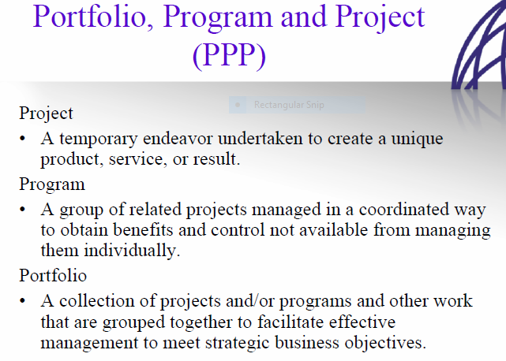

Slide 64
Project maturity Level implementation phases
There are three basic elements and steps to apply project maturity cycle in an organization
  Knowledge
  Assessment
  Improvement

Slide 65
Knowledge
Maturity level is the first iteration of a body of knowledge on the subject of organizational project management and a subset of the larger project management body of knowledge.
Because this standards will form the basis of an organization’s maturity assessment, familiarity with the contents of the standard is essential.

Slide 66
Assessment
In an assessment the organization uses an assessment tool in relation to the body of best practices.
This assessment process will help the organization decide which best practice or groups of best practices to investigate further either to
Confirm competency in an area or to identify constituent capabilities of one or more best practices that need attention.
Project Maturity cycle outlines how to conduct this detailed investigation in the most helpful way for the organization in the most helpful way for the organization, through the use of Directories.

Slide 67
Improvement
The results of the assessment will include a list of capabilities not yet fully developed in the organization.
Maturity lifecycle provides guidance in placing these in order of importance, and this sequence forms the basis for any subsequent plans for improvement.
The actual process of implementing improvements in an organization, which may involve organizational development, change management, restructuring, retaining, and other initiatives, is beyond the scope of this standard.

Slide 68
summary
Implementation of Project maturity level is excellent for aligning an organization’s strategic goals to its corresponding projects.
It enables the organization to run projects more effectively and to realize savings by identifying and eliminating projects that do not fit the organization’s strategic goals.
It also raises the disciplines of project management from an administrative role to strategic planning functions, thereby enhancing the prestige of project management in the organization.
Furthermore, proactively using Project maturity level to feed the strategic plan and set priorities helps an organization choose methods and tools in a more informed fashion.
Tools are therefore more effective, and chances of success and progress are greatly increased.

Slide 69
1.5. Continuous Improvement(CI)
Definition
Continuous improvement, sometimes called continual improvement, is the ongoing improvement of products, services or processes through incremental and breakthrough improvements.
These efforts can seek "incremental" improvement over time or "breakthrough" improvement all at once.
Continuous improvement (CI) is an ongoing effort to improve products, processes, or services by reducing waste or increasing quality. This continuous effort drives a competitive advantage for organizations that get it right but, as with many things in life, consistency is not easy to achieve.

Slide 70
Goal/Purpose of continuous improvement
Continuous improvement strives to accomplish two main goals, namely,
  streamline workflows and
  reduce waste.
Together, these work to reduce costs and optimize outputs, whether that be the quality of a product or service

Slide 71
Four Principles of Continuous Improvement
Principle 1: Stop fixing and start improving
Principle 2: The best practices are the ones you already have
Principle 3: Changing behavior is more important than changing processes
Principle 4: If you aren't failing, you aren't trying

Slide 72
key elements of continuous improvement
Implementation of the continuous improvement model works best when five essential elements are included.
  Goal Alignment
  Employee Engagement
  Control
  Transparency
  Recognition

Slide 73
Management’s Role in Continual Improvement
Management can play the necessary leadership role by doing the following:
  Provide necessary moral and physical support. Physical support comes in the form of resources needed to accomplish the quality improvement objectives.
  Schedule periodic progress reviews and give recognition where it is deserved.
  Build continual quality improvement in the regular reward system, including promotions and pay increases.

Slide 74
Continuous Improvement Tools and Methodologies
The PDCA cycle
Gemba Walks
5 Why's
Toyota kata Coaching from Managers
3M's – Muri, Mura, and Muda
Continuous Improvement Software

Slide 75
1.The PDCA Cycle
PDCA is associated with Edwards Deming
The PDCA cycle (short for plan, do, check, act) provides a systematic approach to testing different ideas and hypotheses.
The framework gives front line teams a four-step guide for executing incremental improvement practices. It enables them to avoid making the same mistakes repeatedly.
Some companies follow a slightly modified PDSA cycle, where the S stands for ‘study’ instead of check.
It facilitates continuous process improvement and empowers employees to test ideas on a small scale. Over time, this creates a culture of creativity and innovation which is difficult for competitors to replicate

Slide 76
PDCA stands for:
  Plan – define your strategic goals and how you’ll achieve them.
  Do – implement the plan and make any changes required to ensure it works.
  Check/Study – evaluate the results and identify opportunities for improvement.
  Act – make adjustments based on what’s found in the previous step.

Slide 77
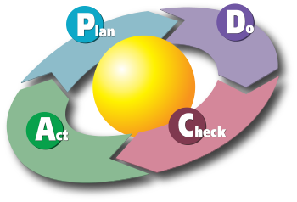
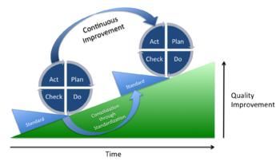

Slide 78
Benefits of PDCA Cycle:
Encourages the methodical way of problem solving and implementing solutions.
Ensures that you plan, test and incorporate feedback before you start full-scale implementation. This brings you closer to your goals as knowledge is increased:
  From solving problems.
  From failures.
  From the feedback received.
Improves the critical thinking skills of your team.
Helps to reach towards a more integrated system.

Slide 79
2.Gemba Walks
In business, Gemba refers to the place where value is created and the general notion is that the best improvement ideas will come simply from going to the Gemba (’bottom-up’ vs. ‘top-down’)
The ‘Gemba Walk’ is an activity that takes management to the front lines to look for waste and opportunities a.k.a. to practice Gemba Kaizen which is similar to the “western” concept of MBWA (Management by Walking Around)

Slide 80
What Gemba Is NOT
Walking around without a purpose
An opportunity to find fault in others
A time for solving problems and making changes
By-passing middle management
Participating or observing a daily or tier management meeting
One place that is not “Gemba” is a manager’s desk

Slide 81
Why the Gemba Walk?
It helps to:
  See what is happening
  Instill discipline (e.g. standard work practices)
  A chance to talk with employees, to hear what problems are not getting solved
  A chance to emphasize quality and safety
  Connect team goals with the organization’s strategy
It is to grasp the situation by involving everyone touching the process to understand purpose, process, and people .Once the situation is understood, improvement is possible and more likely to succeed

Slide 82
Four Steps to Gemba Walk Success
1. Know Your Purpose
2. Know Your Gemba
3. Observe the Framework- Observe the environment and the 5M’s
4. Validate

Slide 83
3. 5 Why’s
The 5 why’s is one of the best continuous improvement tools for root cause analysis.
It can help you to identify the source of a problem and see beyond the superficial issue.
By asking ‘why’ several times in a row, you can dive deeper into the heart of a problem.
This enables you to them come up with potential solutions that accurately address it instead of just treating the symptoms.
It also helps teams to move past apportioning blame or finger pointing to find the real issue.

Slide 84
4. Toyota kata Coaching
The Toyota Kata concept was observed by Mike Rother as part of his research into the car company.
Kata-means behavior patterns or ‘katas’ that were contributing to continuous improvement
One of these katas related to the coaching of employees so that they learn, improve and focus their efforts in the right direction.

Slide 85
It is practically used for a team that is unmotivated or no longer developing, by manager through implementation of:
  Setting regular challenges for them to achieve so that they’re always striving for continuous improvement.
  They are encouraged to develop daily improvement routines or habits that eventually become second nature.
  This approach provides a structure for continuous learning and development.
  This helps to reengage employees who feel stuck or those that have hit a plateau in their professional growth.
  Over time, this contributes to quality improvement and boosts productivity, so that your employees, customers, and bottom line all benefit.

Slide 86
5. 3M’s – Muri, Mura, and Muda
The 3M’s were identified as part of the Toyota lean production system.
They refer to three different categories of deviation that cause problems for companies.
By focusing improvement activities on eliminating the non-value-added activities throughout the production process, and on establishing production flow, balance is naturally achieved between capacity and load.

Slide 87
The 3M’s refer to Japanese words that are usually translated as:
  Muri – overburden caused by lack of resources, poor planning, or too much waste removal.
  Mura – unevenness or irregularities which tend to be the source of ‘muda’ waste issues.
  Muda – waste such as excessive transport, inventory, waiting, overproduction, or defects.

Slide 88
Eight Types of Muda (Waste)
Over-production- Producing more than what the customer needs
Inventory Building and storing extra services/products the customer has not ordered
Transportation
Moving product from one place to another
Rework Reprocessing, or correcting work
Over-processing
Adding excess value when the customer does not require it
Motion Extra physical/mental motion that doesn’t add value

Slide 89
6. Continuous Improvement Software
There are now many digital continuous improvement tools that offer powerful business benefits.
They tend to leverage the best aspects of other improvement tools and combine them into one easy-to-use solution.
Online platforms enable companies to easily capture ideas and feedback from employees.
Some have built-in guides that walk people through continuous improvement processes (such as the PDCA cycle), empowering them to take action

Slide 90
Continuous improvement software also makes analysis and reporting a easier.
Instead of spending time creating complex spreadsheets or gathering key performance indicators from different departments, reports can be generated instantly.
This enables you to see how your company is progressing towards its continuous improvement goals and how productivity, profitability, or quality are being impacted.

Slide 91
END OF CHAPTER ONE

