Slide 1
CHAPTER 3
PLANNING PROJECT QUALITY
  3. 1. Quality Planning
  3.2. Sources of Quality Definition
  3.3. Quality characteristics
  3.4. Output of quality planning

Slide 2
Introduction
The PMBOK® Guide states that quality management processes “…include all the activities of the performing organization that determine quality policies, objectives, and responsibilities so that the project will satisfy the needs for which it was undertaken.” ( A Guide to the Project Management Body of Knowledge ,2004)
A quality policy is a document developed by management to express the directive(guidance) of the top management with respect to quality.
Quality objectives are goals for the value of products, services and processes.

Slide 3
This description is sufficiently general to cover the needs of the project in terms of time, cost, and scope and the needs of the product of the project or customers of the project in terms of the defined requirements.
Project quality management is linked to overall organizational quality management in terms of processes and costs.
Quality management implies the ability to anticipate situations and prepare actions that will help bring the desired outcomes.

Slide 4
Quality objectives can be specific to a department, team process or project.
Examples of quality objectives.
1. Defects: A goal of conformance to specification such as 0.1% of items failing quality control and 0% of produce to being shipped with a defect.
2. Durability: a target for minimum durability of a product such as 20,000 hours of use
3. Efficiency : efficiency of products and services. Eg. A conversation efficiency goal for solar panels.
4. Performance: as measured by a figure of merit ( a particular metric that is used to judge the value of the product [fuels efficiency by miles per gallon]).
5. Timeliness; on time performance such as a train line with a goal of less than 0.1% late arrivals.
6. Stability: as measured by incident is; software as a service target to reduce production incidents (failed event) by 30%.

Slide 5
7. Reliability[ability of things to perform over time in a variety of expected situations] a target of zero bugs in a software release.
8. Availability: A target for uptime of a service e such as 99.99%.
9. Accuracy: The accuracy of the process or service . Example, an inventory management process that seeks to reduce out of stock item by improving forecasting accuracy.
10. Completeness: the variety offered by a service such as an ecommerce sites with target to offer a the greatest variety of products.
11. Customer Service: measured by customer satisfaction
12. Safety:
13. Usability : utility to use friendly.
14. Sensory: objectives related to which are visual appealing, taste, source, touch and smell

Slide 6
3.1 Quality Planning
Definition
The PMBOK® Guide defines quality planning as “…identifying which quality standards are relevant to the project and determining how to satisfy them.”
Quality planning means planning how to fulfil process and product (deliverable) quality requirements.
High quality is achieved by planning for it rather than by reacting to problems after they are identified.

Slide 7
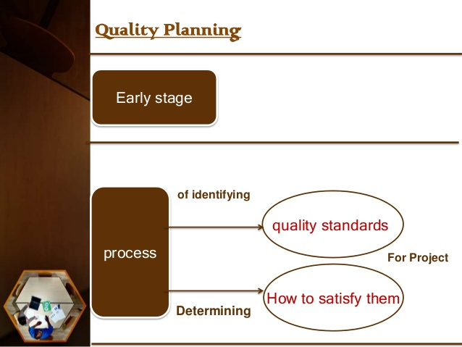

Slide 8
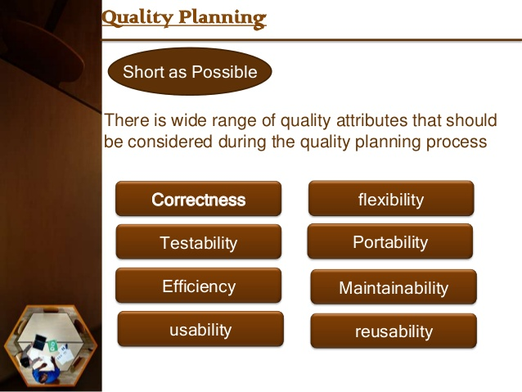

Slide 9
This activity is the foundation for quality being planned in, not inspected in.
Project managers need not, and must not, depend on inspection and correction to achieve project quality.
Instead, they should use conformance and prevention to achieve quality.
Project managers should, through planning, design in and build in quality.

Slide 10
The first step on the quality management is to define quality, the project manager and the team must identify what quality standards will be used in the project, it will look at what the donor, beneficiaries, the organization and other key stakeholders to come up with a good definition of quality.
In some instances the organization or the area of specialization of the project (health, water or education) may have some standard definitions of quality that can be used by the project.

Slide 11
Identifying quality standards is a key component of quality definition that will help identify the key characteristics that will govern project activities and ensure the beneficiaries and donor will accept the project outcomes.
The goal is the prevention of defects through the creation of actions that will ensure that the project team understands what is defined as quality.
Notes:
Quality definition++ quality standards ( characteristics[) +++ Project activities+++ procedures to undertake project activities

Slide 12
What are quality standards?
Quality management standards are details of requirements, specifications, guidelines and characteristics that products, services and processes should consistently meet in order to ensure:
    Their quality matches expectations
    They are fit for purpose
    They meet the needs of their users.
Quality standards are defined as documents that provide requirements, specifications, guidelines, or characteristics that can be used consistently to ensure that materials, products, processes, and services are fit for their purpose.
Standards are an essential element of quality management systems.
Standards are chosen and processes are put in place to achieve those standards.

Slide 13
Purpose of quality management standards
Businesses use standards:
  To satisfy their customers' quality requirements
  Ensuring safety and reliability of their products and services
  Complying with regulations, often at a lower cost
  Defining and controlling internal processes
  Meeting environmental objectives.
Businesses committed to following quality management standards are often more able to:
  Increase their profits
  Reduce losses or costs across the business
  Improve their competitiveness
  Gain market access across the world
  Increase consumer loyalty

Slide 14
Examples of quality management standards
ISO international standards are by far the most widely accepted set of quality standards in the world. ISO 9001:2015 specifies the requirements for a quality management system that businesses can use to develop their own quality agenda.
Types of best practice standards
Standards can help you to achieve best practice in a wide range of business activities, not just quality management.
For example:
  Accessibility standards - can help make services or premises accessible to disabled users
  Health and safety standards- can help reduce accidents in the workplace
  Information security standards - can help keep sensitive information secure
  Food safety standards - can help prevent food from being contaminated
  Environmental management standards - can reduce environmental impact and waste energy management standards - can help cut energy consumption

Slide 15
It is important to design in quality and communicate important factors that directly contribute to meeting the customer’s requirements.
These could be what are the resources, cost, time line, steps and assignment of tasks to achieve the project objectives.
The project quality plan contains all procedures in performing routine activities like material submission, work inspections.

Slide 16
3.2. SOURCES OF QUALITY DEFINITION
Customers are the base in project quality.
They may be classified as external, internal, or hidden.
In the contemporary view, customer requirements define quality, not products or processes.
In other words, it is not what you do or how you do it, but who uses it that counts.
QUALITY IS IN THE PERCEPTION OF THE CUSTOMER.

Slide 17
Identifying Customers
Customers are the base.
Customers may be classified as
    External (the paying client, suppliers, and end users),
    Internal (elements in the supplier-process-customer chain), and
    Hidden (those not directly involved, but concerned about the project’s outcome).
All of this is rather straightforward.
Internal customers may be the most difficult to identify.

Slide 18
Identifying Requirements
Customers are sources of requirements that must be met for project success.
The contract awarded by the paying customer is the most obvious source of requirements.
Contract terms and conditions prescribe what must be done.
Project and organizational elements, including suppliers and subcontractors, are also sources of requirements.

Slide 19
Users and affected groups provide additional requirements, often of great importance to the project team.
“Affected groups” are those that participate in product or service delivery in some way, such as warehouses, transportation providers, original equipment manufacturers, and so on.
Government agencies and other regulatory agencies are also a source of requirements that must not be overlooked.
Last, groups of the concerned provide requirements that must be considered.

Slide 20
Identifying requirements includes defining them in such a way that they are useful to the project team.
Requirements are not vague statements of fantasy, but they are generally stated; details come later.
A good example of a requirement is “Responsive telephone hotline service.”
While the precise meaning is lacking, it provides a foundation for further quality planning.

Slide 21
The sources of quality definition could be from:
1. Donors
One source for definition of quality comes from the donor; the project must establish conversations with the donor to be familiar with and come to a common understanding of what the donor defines as quality.
The donor may have certain standards of what is expected from the project, and how the project delivers the expected benefits to the beneficiaries.
This is in line with the project’s ultimate objective that the project outcomes have the ability to satisfy the stated or implied needs.

Slide 22
2. Beneficiaries
Another source for quality definition comes from the beneficiaries; the project team must be able to understand how the beneficiaries define quality from their perspective, a perspective that is more focused on fitness for use, the project outcomes must be relevant to the current needs of the beneficiaries and must result in improvements to their lives.
The team can create, as part of the baseline data collection, questions that seek to understand how the beneficiaries define the project will meet their needs, and a question that also helps define what project success looks like from the perspective of a beneficiary.

Slide 23
3. The development organization
The development organization may have its own quality standards that can reflect technical and managerial nature of the project.
The organization may require from the project timely and accurate delivery of project information needed for decision making, or compliance to international or locally recognized quality standards that define specific technical areas of the project, this is quite often in health, water and nutrition projects.

Slide 24
A worldwide recognized standard for project is the Sphere Standard (www.sphereproject.org), used for emergency projects whose aim is to improve the quality of assistance provided to people affected by disasters.
This guideline defines the minimum standards for water, sanitation, health, shelter, food security, nutrition, shelter and settlement.

Slide 25
Quality Journey: Specifications
Customers
Requirements
Specifications

Slide 26
Requirements, Standards and Specifications
Requirements are generally stated descriptions of what the project is expected to achieve.
Standards — ways of doing things that are proven and mandatory for use.
Standards address how something is to be done.
Standards guide project implementation.
Specifications are the further detailing of requirements.
Specifications are specific and measurable statements of requirements.
Specifications are exact — they are specific and measurable.
Standards are closely related to specifications.
Specifications provide specific targets for performance.

Slide 27
ISO 9000:2005 defines specification as a document that states requirements. A specification can be related to activities (e.g. procedure document, process specification and test specification), or products (e.g. product specification, performance specification and drawing).
Quality specifications are detailed requirements that define the quality of a product, service or process. Quality includes tangible elements such as measurements and intangible elements such as smell and taste.

Slide 28
Specifications
Exact statement of the particular needs to be satisfied, or essential characteristics that a customer requires (in a good, material, method, process, service, system, or work) and which a vendor must deliver.
Specifications are written usually in a manner that enables both parties (and/or an independent certifier) to measure the degree of conformance.

Slide 29
Example:
A requirement: “Responsive telephone hotline service.”
A specification for this requirement might be: “Answer 99 percent of hotline service calls within one ring.”

Slide 30
Operational definitions
Operational definitions describe what something is and how it is measured.
They are a formal way of answering the question “what do you mean by that?”
Operational definitions provide a link between requirements and specifications.
Operational definitions remove ambiguity of terms by describing what something is and how it is measured.

Slide 31
Both Deming and Juran emphasized the importance of operational definitions in their work. Here are two examples:
“Responsive” telephone hotline service — The amount of time before a call is answered expressed as the number of rings as measured by the automated telephone data system.
2. “Hot” coffee — The temperature of the coffee as measured by a standard Fahrenheit thermometer after standing in a Styrofoam cup for three minutes in a room with ambient temperature of no less than sixty-eight degrees.

Slide 32
Both of these operational definitions provide clarification of ambiguous terms — “responsive” and “hot” — and allow the project team to develop specifications by rational analysis rather than guesswork.
Moving from requirements to specifications is a three-step process:
1. Identify a requirement.
2. Develop an operational definition.
3. Develop a specific value against which performance will be measured to determine success.
Specifications may be provided by the paying customer in the contract or provided by other customers informally.
Even specifications in the contract may require customer coordination to ensure understanding by all project participants.

Slide 33
3.3. Quality Characteristics
All material or services have characteristics that facilitate the identification of its quality.
The characteristics are part of the conditions of how the material, equipment and services are able to meet the requirements of the project and are fit for use by the beneficiaries.
Quality characteristics relate to the attributes, measures and methods attached to that particular product or service.

Slide 34
Types of Quality Characteristics
Functionality : is the degree, by which equipment performs its intended function, this is important especially for clinical equipment, that the operation should be behave as expected.
Performance, its how well a product or service performs the beneficiaries intended use.
A water system should be designed to support extreme conditions and require little maintenance to reduce the cost to the community and increase its sustainability.
2. Reliability, it’s the ability of the service or product to perform as intended under normal conditions without unacceptable failures.
Material used for blood testing should be able to provide the information in a consistent and dependable manner that will help identify critical diseases. The trust of the beneficiaries depend on the quality of the tests.

Slide 35
Relevance, it’s the characteristic of how a product or service meets the actual needs of the beneficiaries, it should be pertinent, applicable, and appropriate to its intended use or application
Timeliness, how the product or service is delivered in time to solve the problems when its needed and not after, this is a crucial characteristic for health and emergency relief work
Suitability, defines the fitness of its use, it appropriateness and correctness, the agriculture equipment must be designed to operate on the soul conditions the beneficiaries will use it on.
Completeness, the quality that the service is complete and includes all the entire scope of services. Training sessions should be complete and include all the material needed to build a desired skill or knowledge
Consistency, services are delivered in the same way for every beneficiary. Clinical tests need to be done using the same procedure for every patient.

Slide 36
Quality characteristics are not limited to the material, equipment or service delivered to the beneficiaries, but also applies to the material, equipment and services the project staff uses to deliver the project outputs.
These include the vehicles, computers, various equipment and tools and consulting services the project purchases and uses to carry out its activities.
Quality characteristics must be included in all material, equipment and services the project will purchase, the procurement officers must have a complete description of what is required by the project, otherwise a procurement office may purchase the goods or services based on her or his information of the product.

Slide 37
Illustration
What went wrong –
A project requested the purchase of 1000 tents for a community displaced by floods, the purchase request had no specifications for its intended use (suitability), and resistance (performance). The procurement officer only knew that the tents were needed as soon as possible( timeliness), so he purchased, based on his knowledge of what a tent looks like, 1000 camping tents, they were delivered to the refugee camps on the requested timeframe, and the project manager was happy. But the next day all families that received the tents were complaining that they were not good for the cold nights and too small to accommodate their extended families. The project purchased the tents under budget and within the specified timeframe but the beneficiaries rejected them because they did not meet their needs (quality)

Slide 38
2.4. Quality Management Plan
The basic document for project quality is the quality management plan.
It is one of the several subordinate management plans within the project plan.
It may be best for project teams to craft an individual quality management plan that fits the needs of the project.

Slide 39
Quality Plan
A quality plan is a document, or several documents, that together specify quality standards, practices, resources, specifications, and the sequence of activities relevant to a particular product, service, project, or contract.
Quality plans should define:
  Objectives to be attained (for example, characteristics or specifications, uniformity, effectiveness, aesthetics, cycle time, cost, natural resources, utilization, yield, dependability, and so on)
  Steps in the processes that constitute the operating practice or procedures of the organization
  Allocation of responsibilities, authority, and resources during the different phases of the process or project
  Specific documented standards, practices, procedures, and instructions to be applied
  Suitable testing, inspection, examination, and audit programs at appropriate stages
  A documented procedure for changes and modifications to a quality plan as a process is improved
  A method for measuring the achievement of the quality objectives
  Other actions necessary to meet the objectives

Slide 40
At the highest level, quality goals and plans should be integrated with overall strategic plans of the organization. As organizational objectives and plans are deployed throughout the organization, each function fashions its own best way for contributing to the top-level goals and objectives.
At lower levels, the quality plan assumes the role of an actionable plan. Such plans may take many different forms depending on the outcome they are to produce. Quality plans may also be represented by more than one type of document to produce a given outcome.

Slide 41
A general framework for quality management plans includes four elements:
  Quality Policy
  Who is in charge?
  Where are we going?
  How are we going to get there?

Slide 42
Quality policy
This expresses the intended direction of a performing organization with regard to quality.
One of the best examples of a clear, concise quality policy is “We shall build good ships here; at a profit if we can, at a loss if we must, but always good ships” (Collis P. Huntington, Newport News Shipbuilding and Dry Dock Company, 1893).
The project team may simply apply the existing organizational quality policy, but only if it is a good fit.
Needs of the project may demand a quality policy that is more specific than a generally stated organizational quality policy.

Slide 43
2. Who is in charge?
This question is one of three that lie at the heart of quality management.
The answer is neither trivial nor simple; it is not just the name of the project manager.
A complete answer — one essential to project success — addresses project and organizational infrastructure and describes participants, reporting chains, and responsibilities.
There are few more certain paths to project failure than an ambiguous collection of participants in which everyone is in charge, but no one is responsible.

Slide 44
3. Where are we going?
Managing quality effectively depends on specific performance targets.
Goals provide broad descriptions of what the project is expected to achieve.
Requirements provide more detailed descriptions.
Operational definitions, which describe what something is and how it is measured, provide the means for understanding goals and requirements that may be vague or ambiguous.

Slide 45
4. How are we going to get there?
The answer to this question should address processes, resources, and standards.
Processes define the things the project team will do to meet requirements and achieve project goals.
The quality management plan may include a lengthy list of processes covering many different aspects of project work.

Slide 46
Resources include more things than money.
This part of the plan should describe the people available, participating organizational elements, tools to be used, and, of course, the budget that provides funding for all quality activities.
Standards to be applied to project work are an important element of this part of the plan.
Remember that, by definition, quality planning is all about identifying relevant standards.

Slide 47
Quality Planning and Project Planning
It is essential that customer and requirement prioritization be completed early in the project, before the project plan or project design has been completed.
Not doing so may result in a project plan that takes you someplace you did not want to go.

Slide 48
Summary
Quality management includes quality planning, quality assurance, quality control, and quality improvement.
The quality management plan is part of the project plan.
It includes the quality policy (intended direction of the organization regarding quality) and answers the questions: Who is in charge? (infrastructure and responsibilities), Where are we going? (goals), and How are we going to get there? (processes).
Quality planning is identifying which quality standards are relevant to the project and how to satisfy them.
Quality planning is the foundation that allows quality to be planned in, not inspected in.
End of Chapter 2

